Slide 1
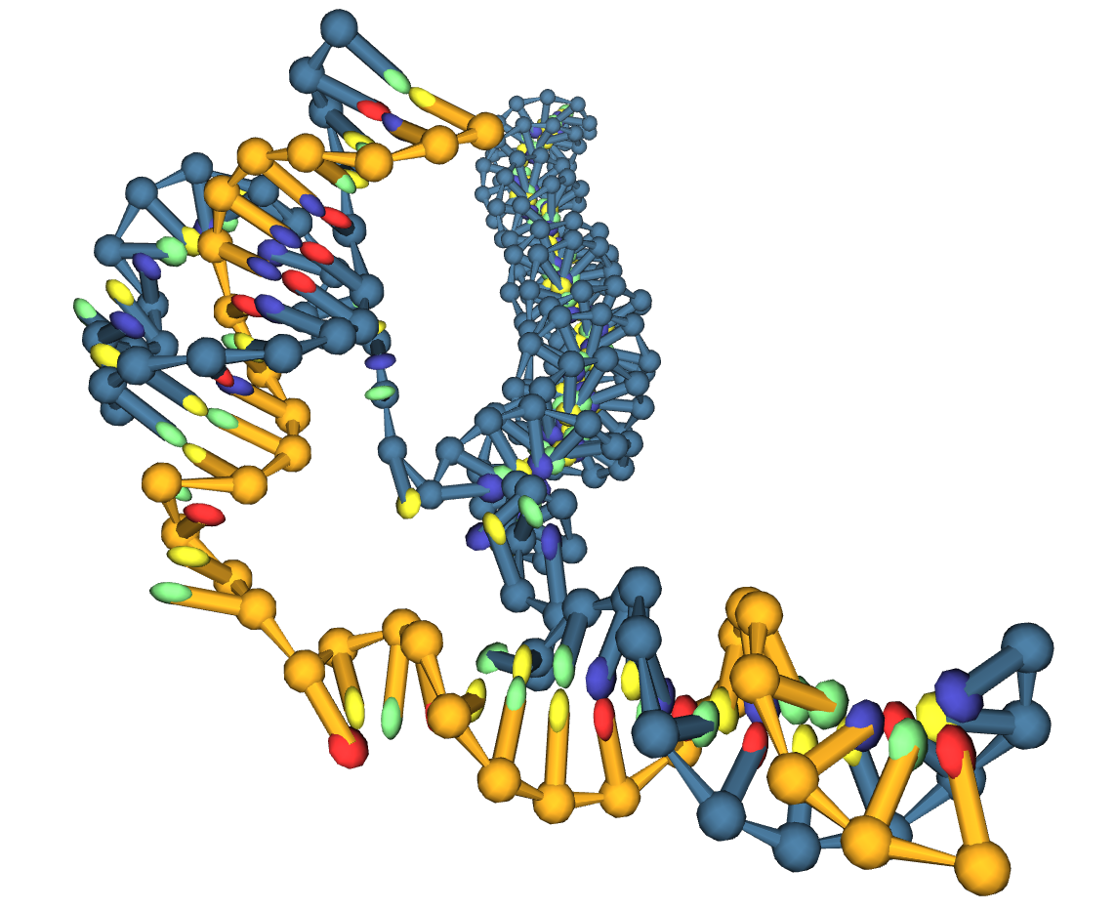

Course-Grain Modelling of
DNA Triplet Repeat Slip-out Migration
X THE PLACE OF USEFUL LEARNING
Lewis M Russell | SN: 201817988
Supervisor | Dr Oliver Henrich
Date | 16/11/2022

Slide 2
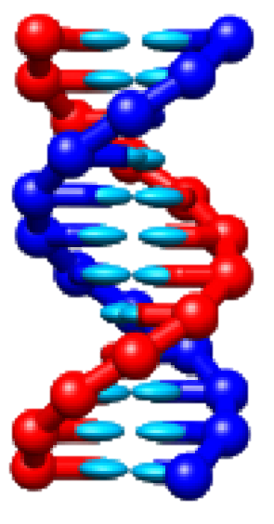
Motivation for Triple Repeat Slip-Out Research
A

Slide 3
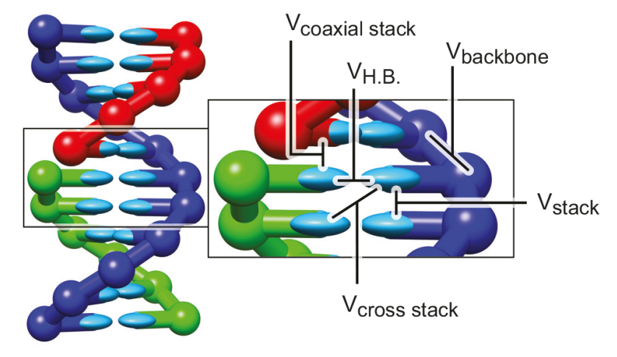
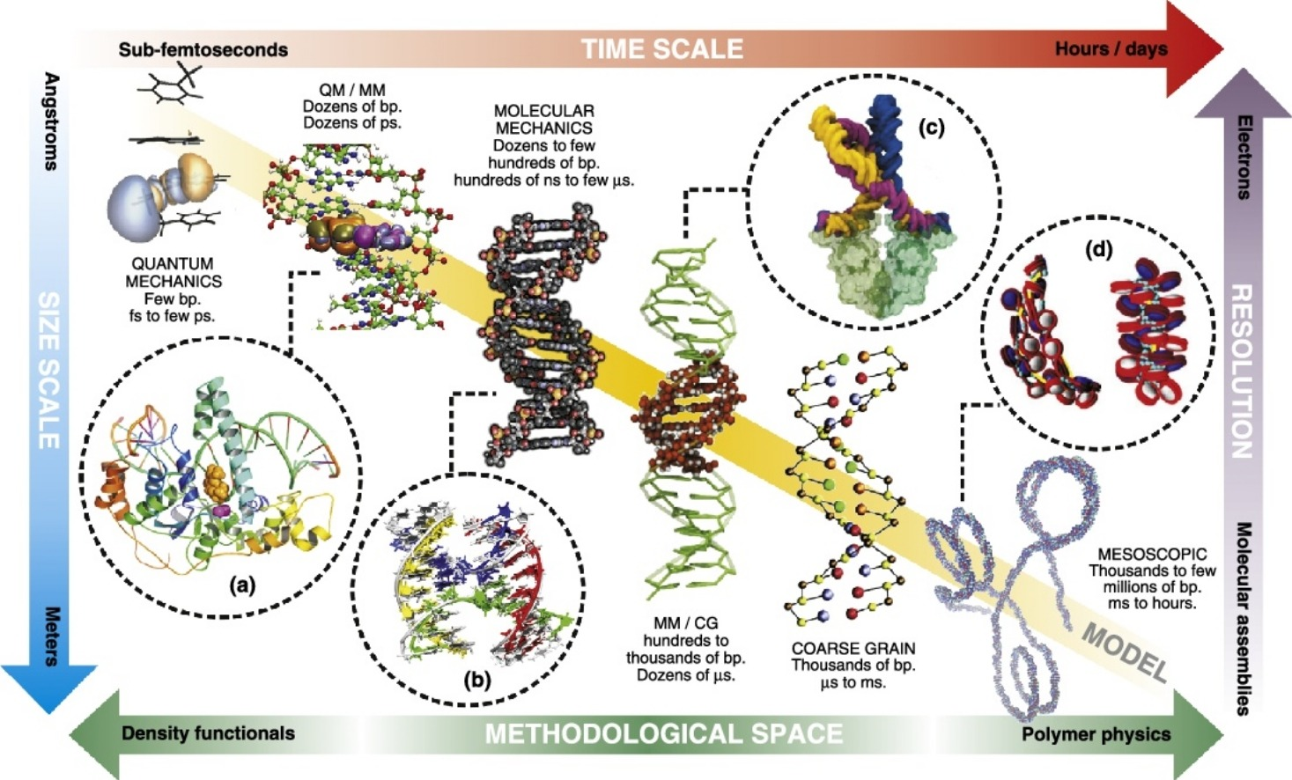
Coarse-Grain Modelling
†
*
*Figure From:
Pablo D Dans, J¨urgen Walther, Hansel G´omez, and Modesto Orozco. Multiscale simulation of dna. Current opinion in structural biology, 37:29–45, 2016.
†Figure From:
Petr Sulc, Flavio Romano, Thomas E Ouldridge, ˇ Lorenzo Rovigatti, Jonathan PK Doye, and Ard A Louis. Sequence-dependent thermodynamics of a coarsegrained dna model. The Journal of chemical physics, 137(13):135101, 2012.
oxDNA / CG-DNA

Slide 4
Rationale for an Improved Modelling Approach
A

Slide 5
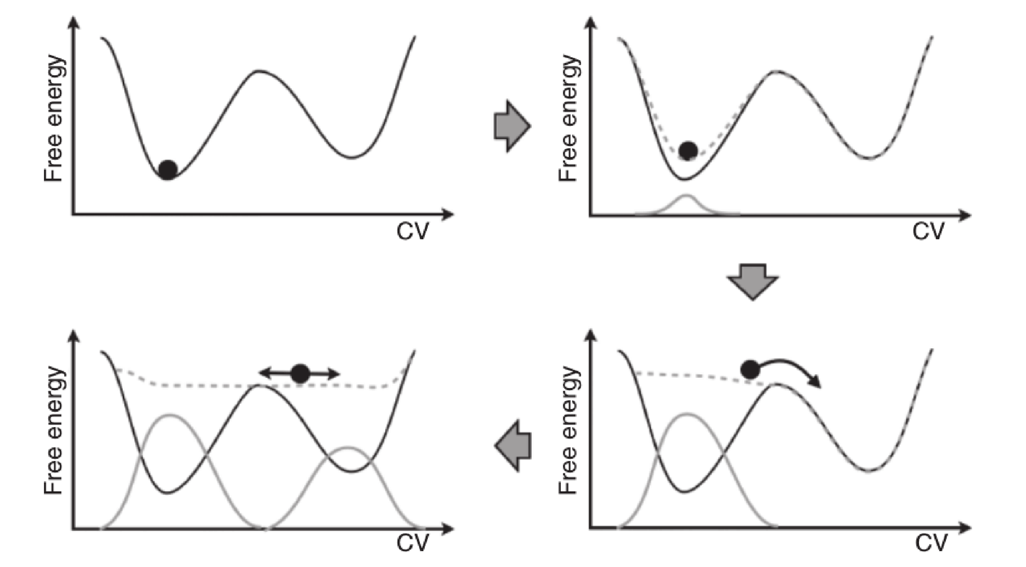
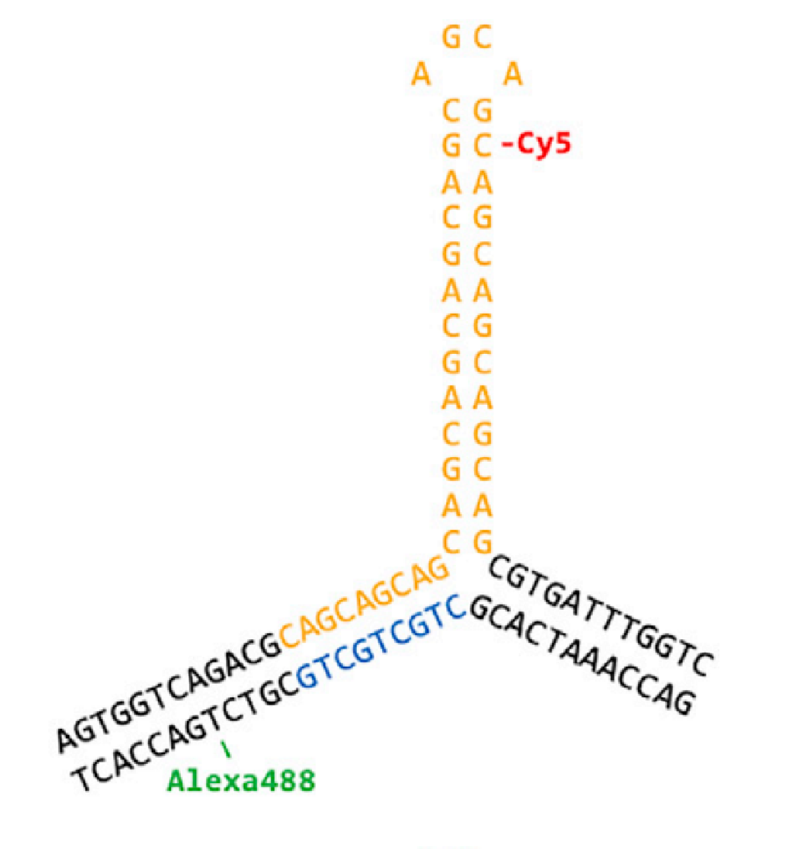
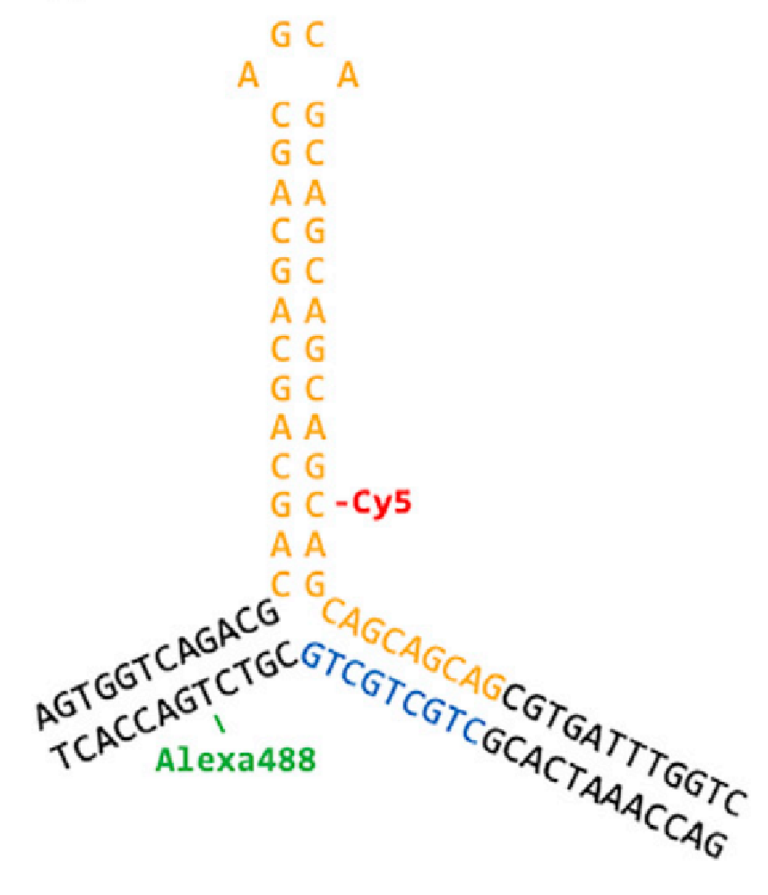
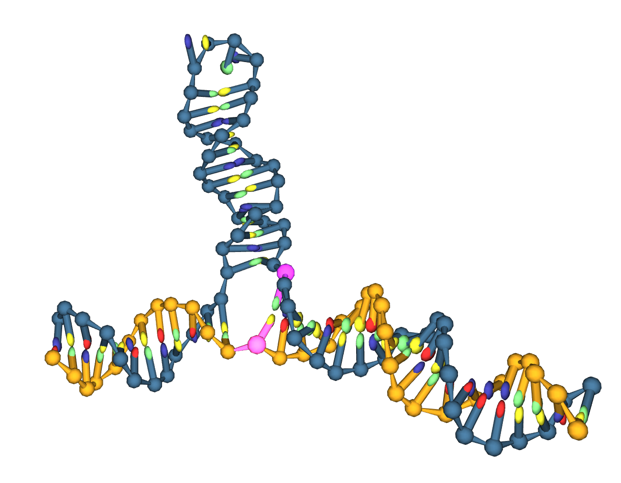
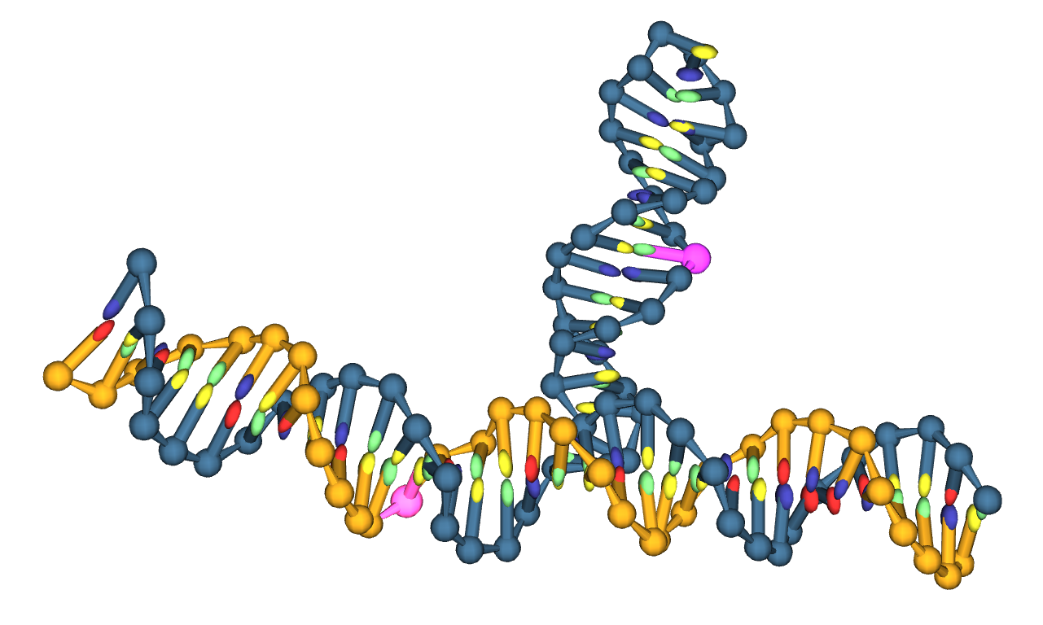
State Sampling
Multiple Local Minima = Difficult to sample using conventional MD
?

Slide 6
Well-Tempered to Transition-Tempered MetaD
Principle of Metadynamics
WTMetaD
Reduces HILLS via exp decay
HILLS only time-dependant
Imprecise FES Convergence
TTMetaD
Reduces HILLS based on FES and CV
HILLS not time-dependant
Complete Sampling of FES
*
*Figure From:
Giovanni Bussi and Davide Branduardi. Free-energy calculations with metadynamics: Theory and practice. pages 1–49, 05 2015

Slide 7
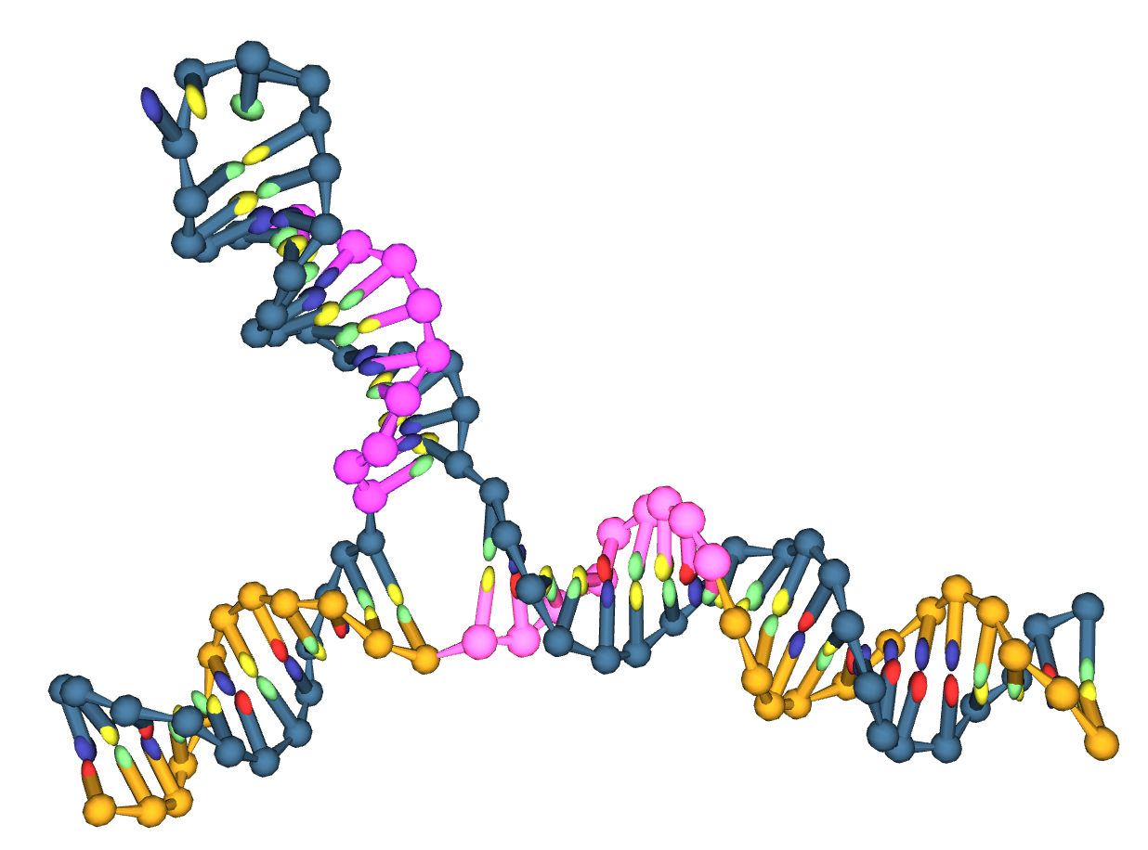
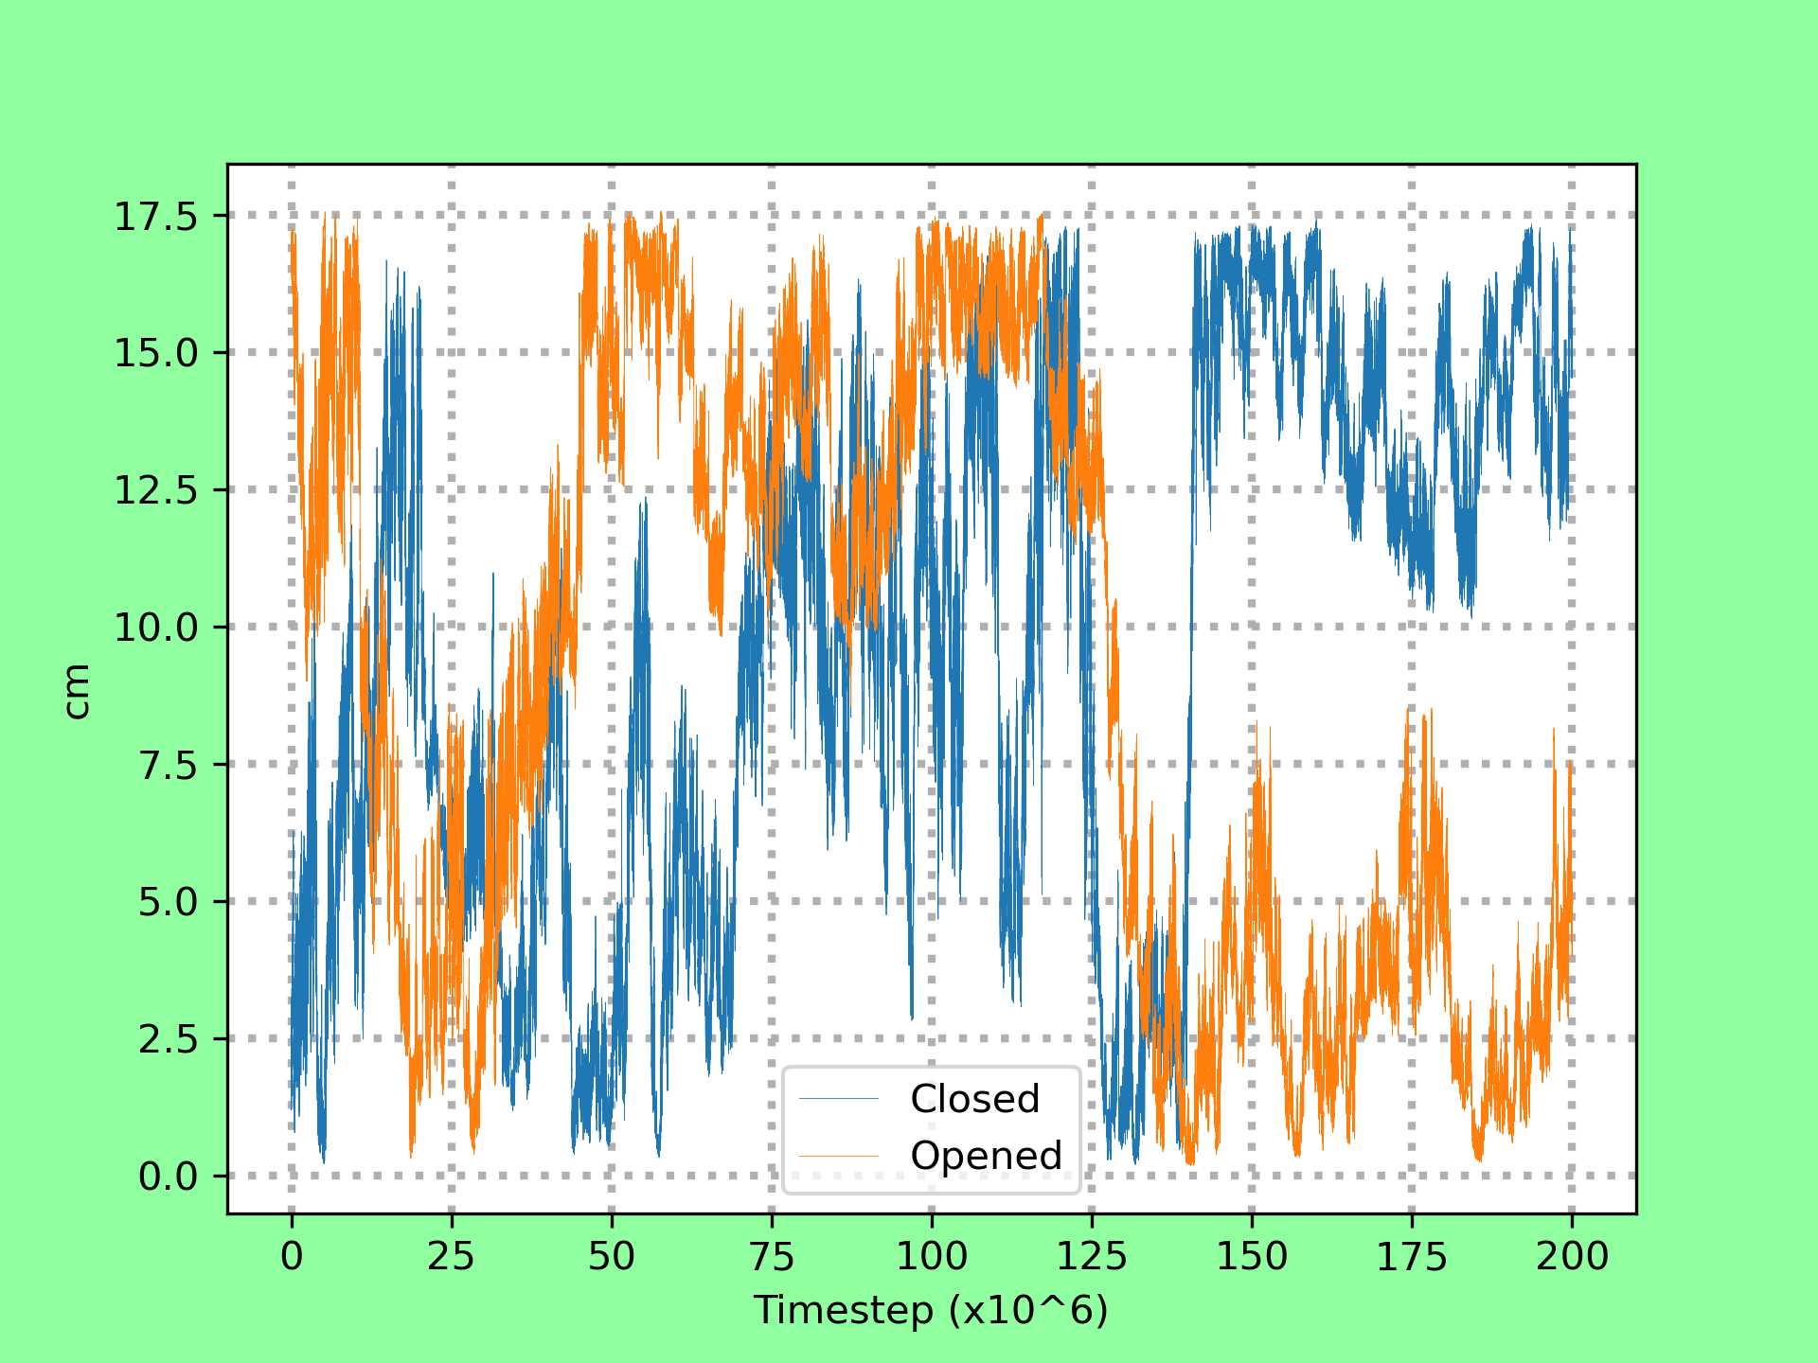
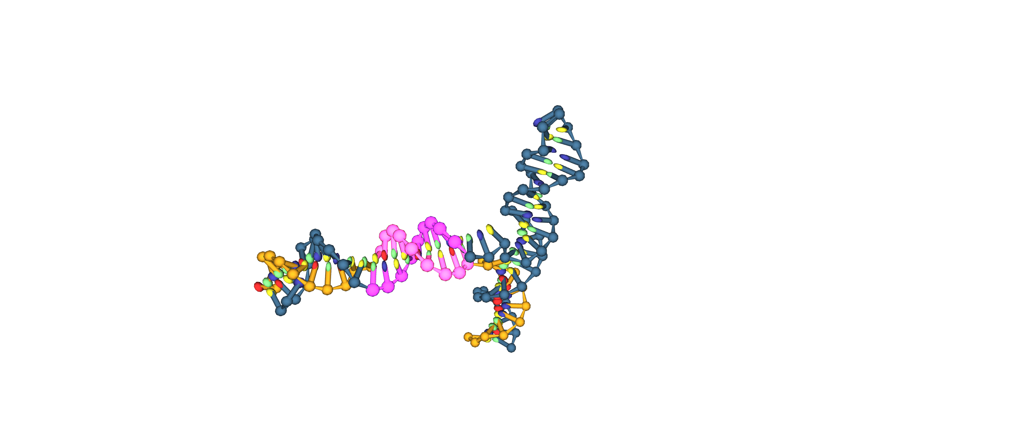
Contact Maps and Collective Variables
Collective Variables
A
B
Denature
Hybridise
Timestep = 0
Timestep = 188M
A
B
Documentation | https://www.plumed.org/doc-v2.7/user-doc/html/_c_o_n_t_a_c_t_m_a_p.html

Slide 8
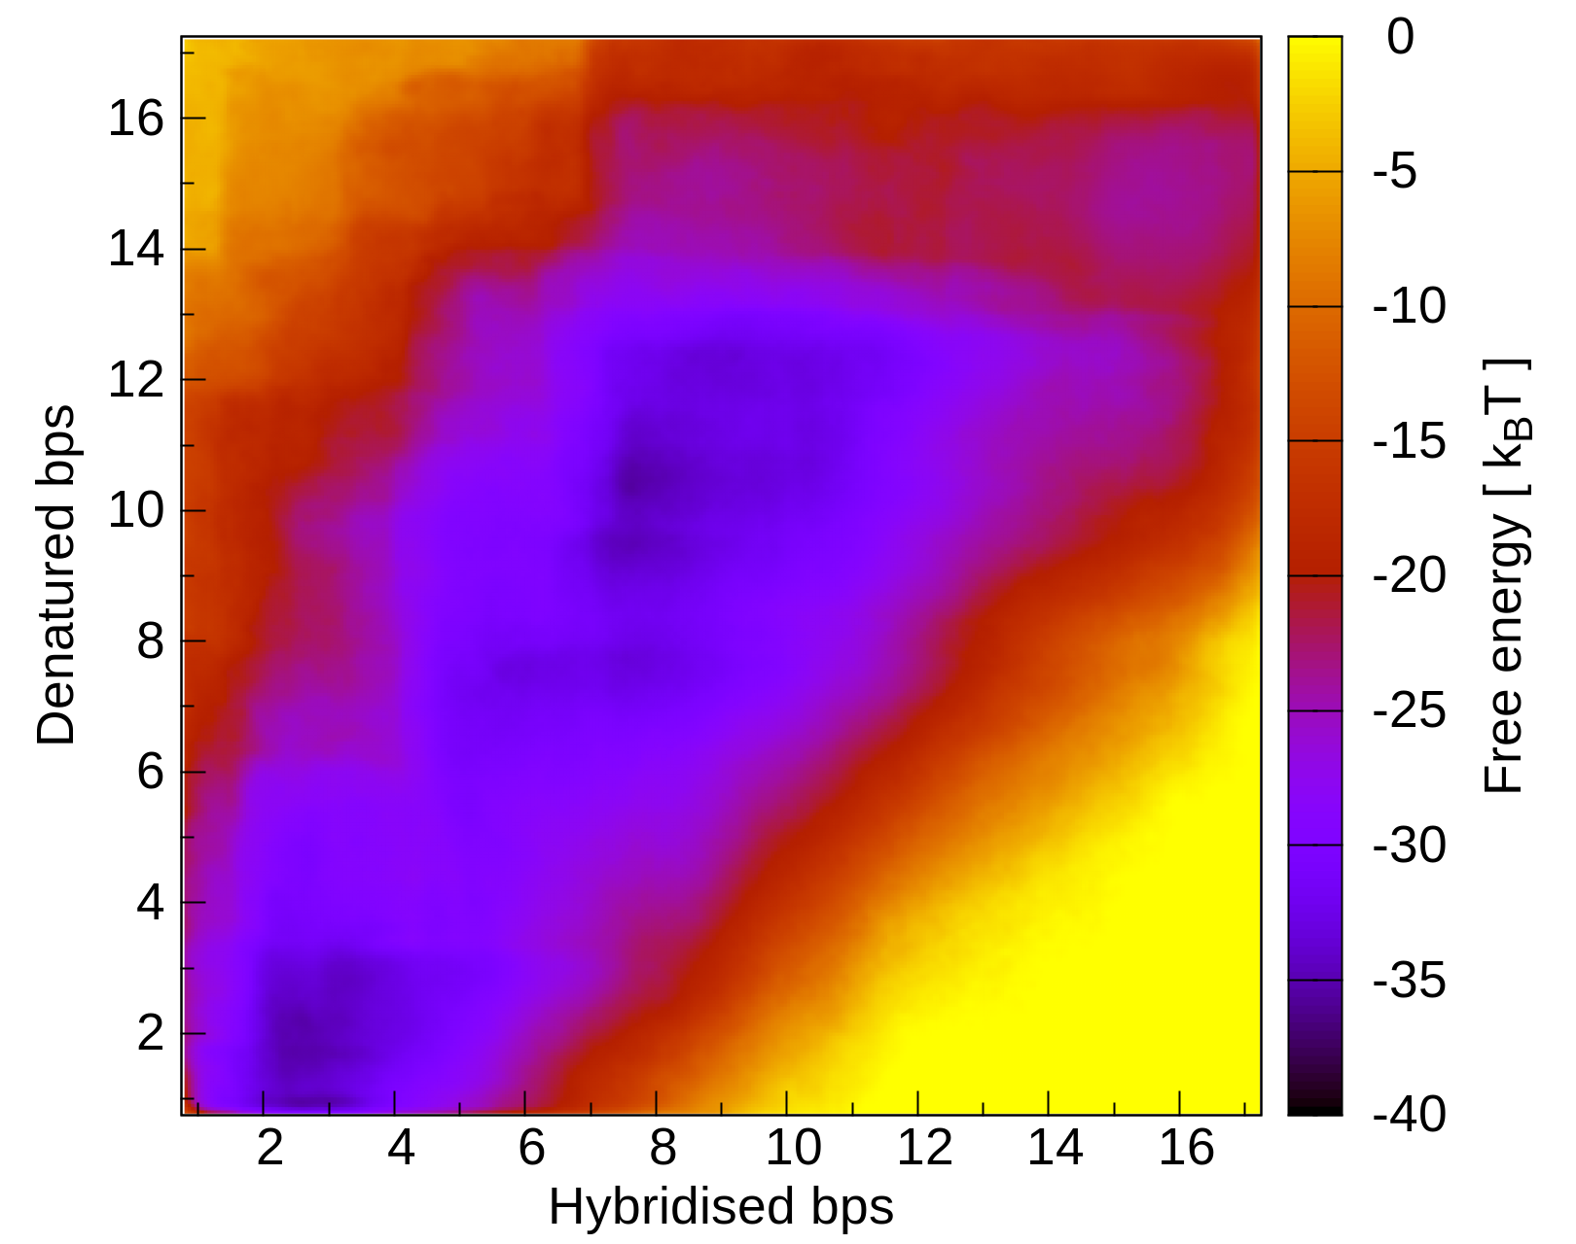
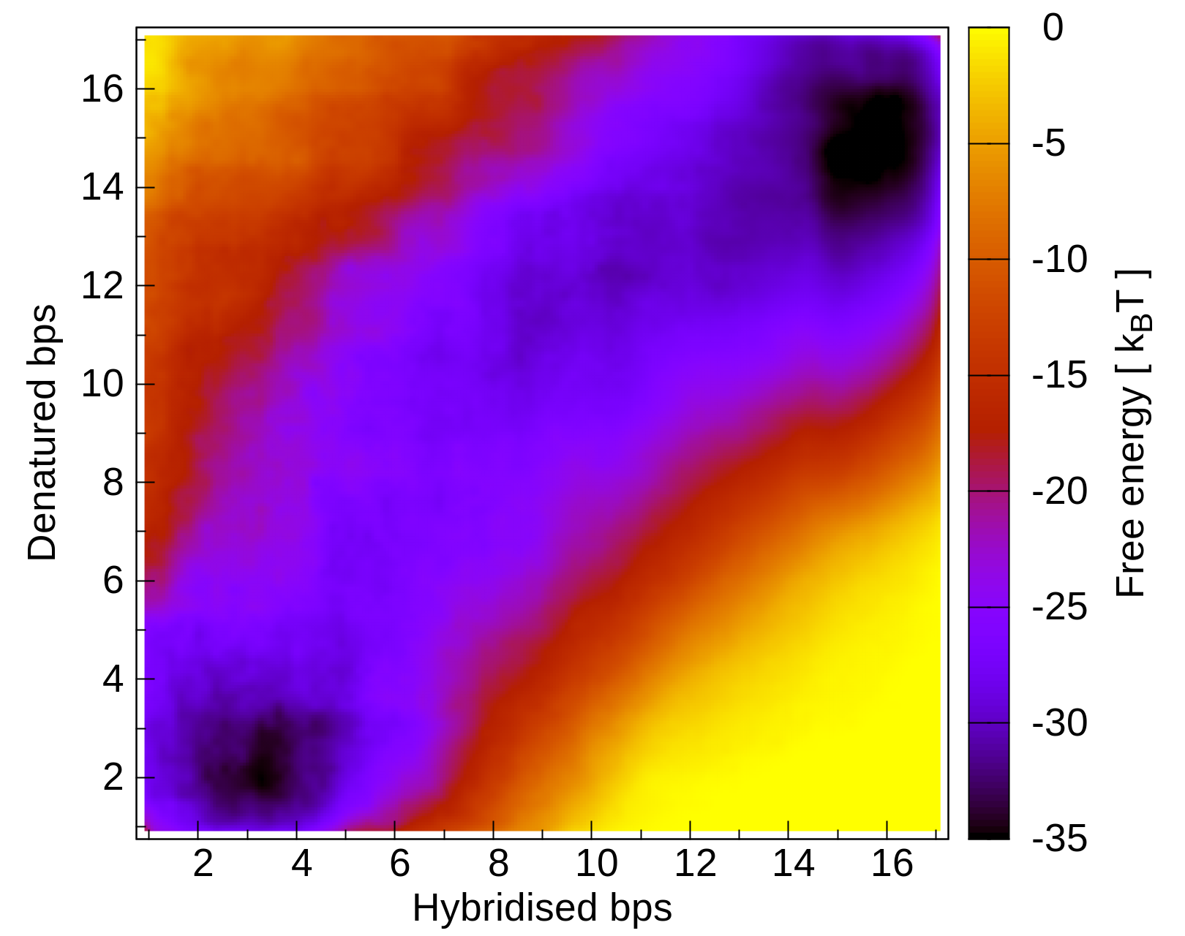
Free Energy Landscapes
WTMetaD, CTG_10
TTMetaD, CTG_10

Slide 9
Conclusion and Remaining Work
CG-Modelling matching Experimental Findings*
Results so far for CTG/CAG_10
CAG_40 and CTG_30 ?
A Few Useful Links:
https://www.lammps.org/ | https://docs.lammps.org/Packages_details.html#pkg-cg-dna
https://dna.physics.ox.ac.uk/index.php/Main_Page
.ppt here on my GitHub | https://github.com/lrussell676/Public_Yr_4_Files/blob/main/PH450%20Talk.pptx
* Simona Bianco, Tianyu Hu, Oliver Henrich, Steven W. Magennis, Heterogeneous migration routes of DNA triplet repeat slip-outs, Biophysical Reports, Volume 2, Issue 3, 2022, 100070, ISSN 2667-0747, https://doi.org/10.1016/j.bpr.2022.100070.

Slide 10
X THE PLACE OF USEFUL LEARNING

